Slide 1
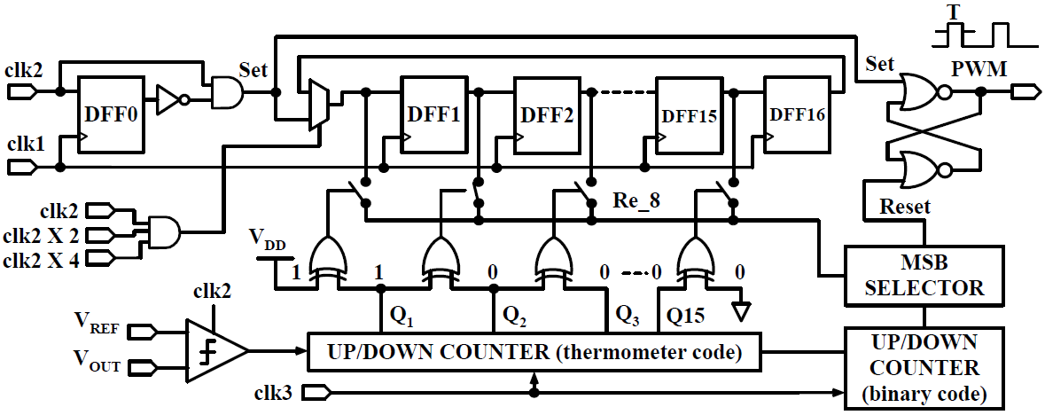
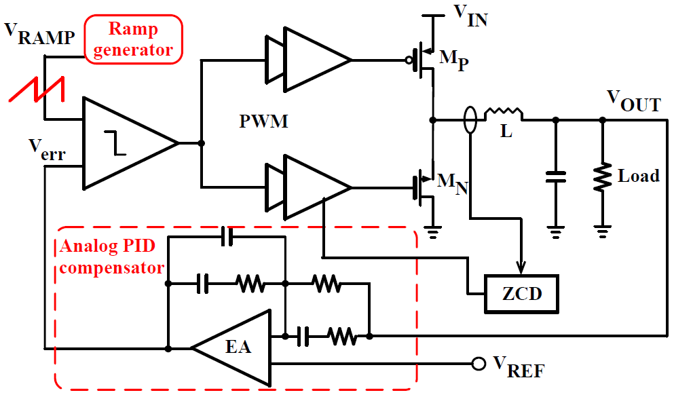
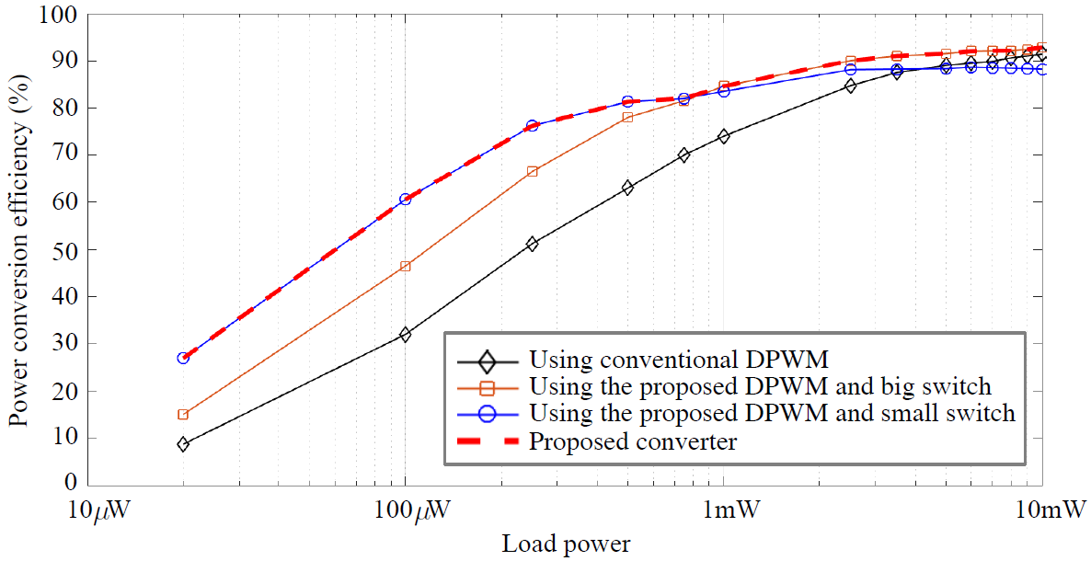
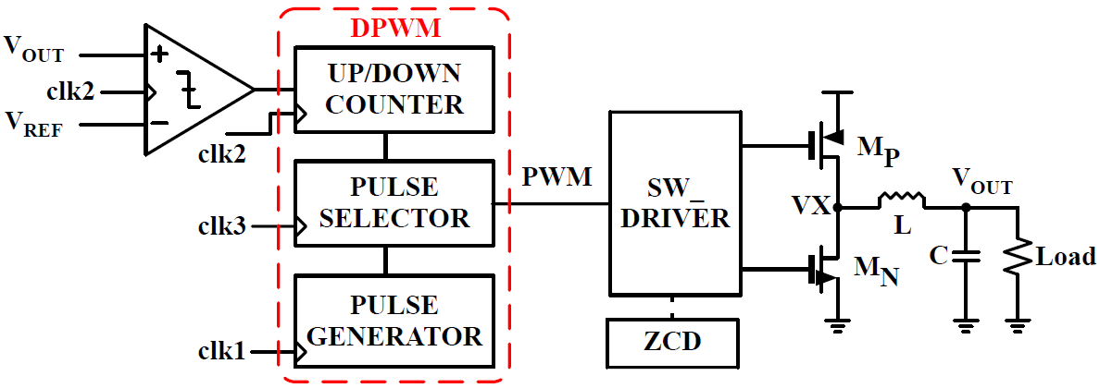
Design of a DC-DC Converter Customized for Ultra-Low Voltage Operating IoT Platforms
Myeong-Gyu Yang, Dong-Kyu Jung, Bo-Kyong Choi, and Kwang-Hyun Baek
School of Electrical and Electronics Engineering,
Chung-Ang University, Seoul, Republic of Korea
Introduction
Proposed DPWM Designs
Ultra-low power (ULP) IoT platforms are drawing attention from academia and industry by offering the most practical solution on how to extend the service life of IoT devices under limited small energy sources such as thin film batteries, photovoltaic cells, and thermoelectric generators.
However, to get the most out of the ULV operation and to take full advantage of the special low power methods, there is a critical device that should not be overlooked: a DC–DC converter. In this paper, focusing on the digital pulse width modulator(DPWM) in a DC–DC converter that can ensure the reliable operation of the converter for the target IoT platforms, we first propose a high resolution and low-power DPWM architecture. We then utilize the proposed DPWM to control the multiple parallel-connected switches in the DC–DC converter to improve $η$ under wide load power conditions.
Issues on Conventional PWM Designs
Figure 5. Block diagram of the proposed DPWM.
In order to minimize the power and area overhead of the DPWM, we propose an idea of designing a pulse generator that has a small number of DFFs, but each DFF is repeatedly used to generate multiple delay pulses. The proposed DPWM structure is described in Figure 5, which supports 7-bit (higher than the conventional 6-bit) resolution. As seen in the figure, the Set pulse is generated by using clk1 and clk2. The pulse generator with 16 DFFs uses Set pulse and clk1 to make 16 delay pulses. Then, by exploiting the feedback mechanism, the output pulse from the 16th DFF enters the 1st DFF to generate the next 16 delay pulses, which are repeated for 8 times so as to have a total 27 delay pulses. The feedback mechanism is implemented by using clk2, clk2x4, clk2x8 and AND gate. Note that, this additional clock generation can increase the power consumption of the clock driver, but as the resolution of the DPWM increases, the difference in the number of nodes connected per clock within conventional and proposed DPWMs can overwhelm this overhead. In other words, as the resolution increases, the clock driver uses a much smaller number of buffers in the proposed design, so that the reduced power consumption can be greater than the power consumption increase due to the additional clocks. In fact, the power consumption of the clock driver in the proposed 7-bit DPWM is slightly less than that of the 6-bit conventional DPWM, and if the number of bits goes up, the difference will be even greater.
Figure 1. Structure of a DC–DC converter with the analog pulse width modulator (APWM).
The APWM exposes serious weakness at low supply voltage, in that the ramp generator and EA in the APWM tend to malfunction. More precisely, these analog circuits are designed to have multiple MOS stacks due to performance and stability issues, which is problematic because the voltage headroom that MOS stacks require for normal operation is not guaranteed at low supply voltages.
Measured Results
Figure 3. Structure of a DC–DC converter with the digital pulse width modulator (DPWM).
Figure 8. Measured $η$ of the conventional and proposed converters.
The conventional DPWM designs have significant limitations with the exponential increase in power and area overhead as the resolution of the DPWM increases. The conventional DPWM architecture with n-bit resolution must have the $2^{n}$number of D flip-flops (DFFs) in the pulse generator.
In the figure, the black line with diamond marks indicates the efficiency of the converter with conventional DPWM and one big switch, which shows that $η_{min}$and $η_{max}$ are 8.7% and 91.4%, respectively. The efficiency of the converter using the same big switches but with the proposed DPWM is indicated by the orange line with square marks, showing that $η_{min}$ and $η_{max}$ are 15.2% and 92.8%, respectively.
본 MPW는 IDEC 지원을 통해 제작하였음

